Slide 1




Hydrometallurgical recovery of tin and copper from mobile phone printed circuit boards.
GDR Prométhée Scientific Days
L’Hôte Marianne¹, Meux Eric¹, Leclerc Nathalie¹, Philippe Pierrat², Hervé Muhr³, Yosri Khalsi⁴, Frédéric Diot⁵
Thursday June 5th 2025, ISEA Metz
¹ Institut Jean Lamour, Metz
² Laboratoire Lorrain de Chimie Moléculaire, Metz
³ Laboratoire Réactions et Génie des Procédés, Nancy
⁴ CRITT-Techniques Jet Fluide et Usinage, Bar-le-Duc
⁵ GeoRessources, Vandœuvre-lès-Nancy

Slide 2
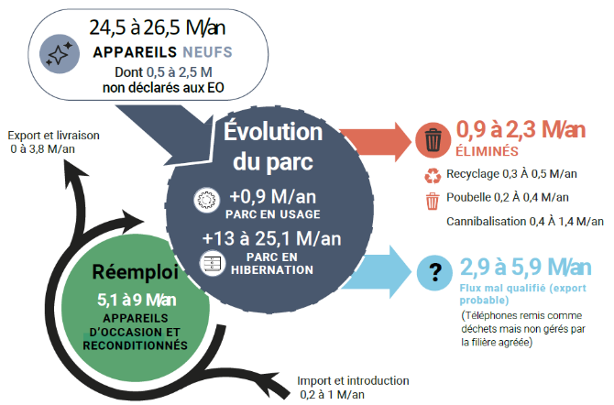
Introduction
THYMO Project (HYdrometallurgical Treatment of MObile phones)
Over 120 millions mobile phone remain in French drawers !
Flows and fleets of mobile phones in France in 2018. [1]
[1] Sofies and Bio Innovation Service (2019). Étude du marché et parc de téléphones portables français en vue d’augmenter durablement leur taux de collecte.
Notes:
Mise sur le marché

Slide 3
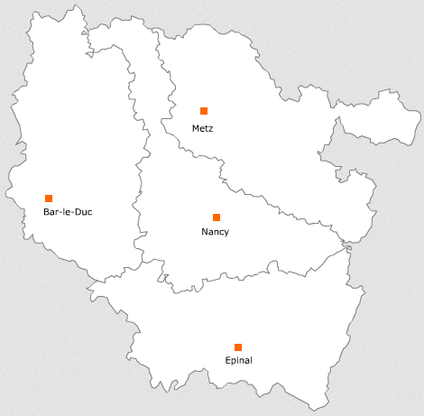




THYMO Goals
Develop an innovative process for recycling cell phone circuit boards:
low environmental impact
energy-efficient
enables maximum recovery of metals
enables the “polymer” part of the board to be recovered
Use a significant quantity of circuit boards to obtain realistic raw material
Collection of over 19000 mobiles phones

Slide 4

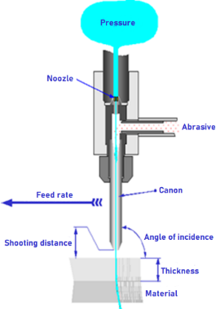
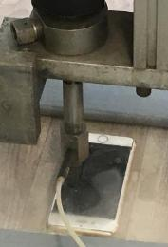

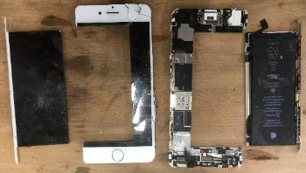
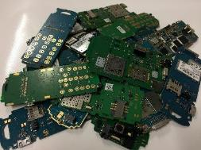
Phone disassembly
Automated process by CRITT-TJFU
Printed circuit boards or PCBs
Theoretical industrial rate : up to 400 phones per minute
Notes:
Centre de recherche
Reactif eau abrasif, et sera recyclée

Slide 5

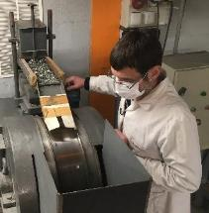
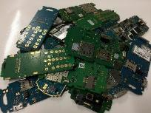
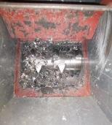
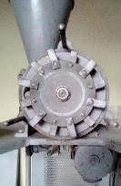
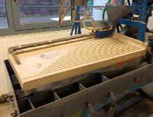
PCBs Shredding
Pre-treatment
Magnetic sorting
Eddy Current
PCBs from
CRITT TJFU
Shredding to 8 mm
Shaking table
Sizing < 500 µm
Shredding (hammer mill)
Light fraction : epoxy resin, glass fibers, aluminum
Heavy fraction : metals, ceramics (BaSO₄, Al₂O₃)
Notes:
Photo table secousses

Slide 6
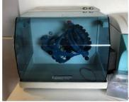


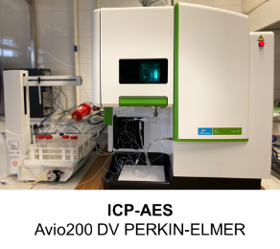
Characterization
Characterization protocol
Shredded PCBs
Homogenization
200 g
3 replicates
Aqua regia leaching
20 mL HNO₃/HCl
P_{max} = 1,8 kW T° = 220 °C t = 20 mn
500 mg
Filtering 0,45 µm
Solid residues
Leachate
XRD, CHNS
ICP-AES
Elementary analysis
Notes:
Ne pas dire « plus en détails » Rajouter concentration eau régale
Dire que mon travail ici

Slide 7
Characterization
PCB shred composition
Metals | Weight fraction (%)
Cu | 52-70
Sn | 7-15
Ni | 2-4
Al | 0.2-1.2
Fe | 0.9-1.8
Zn | 0.2-1.6
Pb | 0.1-1
Ag | 0.03-0.2
Au | 0.1-0.15
Pd | < 0.05
90 % of market value
Notes:
AGGRANDIR

Slide 8
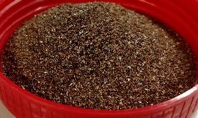
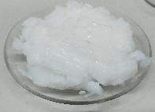




Process overview
Leaching H₂O₂ / H₂SO₄
Shreds (∅ < 500 µm)
L/S separation
Residues (Ag₂SO₄, PbSO₄, Au, Pd…)
Leachate (Cu²⁺, Sn⁴⁺, Ni²⁺, Zn²⁺, Al³⁺, Fe³⁺)
NaOH
SnO₂, xH₂O precipitation
Stannic acid
Phytic acid
Removal of Al³⁺ and Fe³⁺
Metallic phytates
Metallic copper
Copper electrolysis
Ni²⁺ and Zn²⁺ solution
Notes:
On ne « créer » pas de phytates
Dire élimination é
Dire précipitation phyate
ventuelles si concen

Slide 9
Leaching step

Slide 10
Leaching step (1/3)
Reagents
H₂O₂-H₂SO₄ (H₂O₂ considered as a green oxidant)
Cu_{(s)} + H₂O_{2 (aq)} + 2 H⁺_{(aq)} → Cu²⁺_{(aq)} + 2 H₂O_{(l)}
Sn_{(s)} + 2 H₂O_{2 (aq)} + 4 H⁺ _{(aq)} → Sn⁴⁺ _{(aq)} + 4 H₂O_{(l)}
Constraints
Limit H₂O₂ dismutation (temperature, catalysis by Cu²⁺, Fe²⁺, Fe³⁺)
Avoid CuSO₄, 5H₂O precipitation (solubility of 207 g/L in water at 20°C)
Avoid prematured precipitation of SnO₂, x H₂O

Slide 11
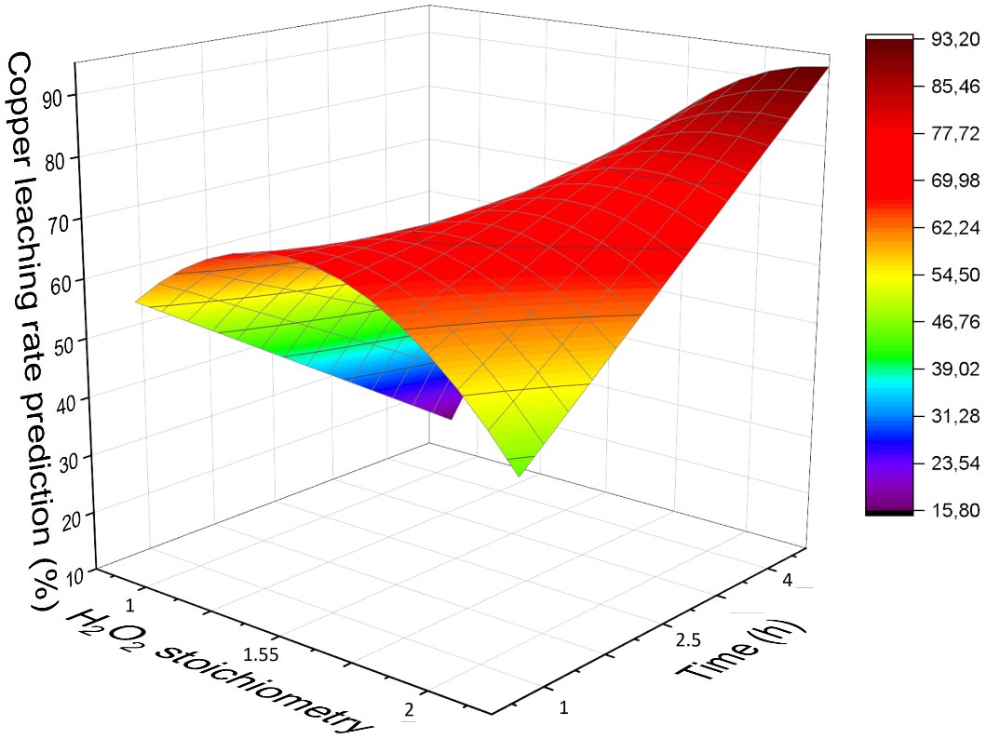
Leaching step (2/3)
Optimization – Design of Experiments
Fractional factorial design 2⁴⁻¹ then central composite design
Optimal conditions
n H₂O₂ / Σ n métaux = 2
n H⁺ / Σ n métaux = 6
Leaching time = 4h
Liquid/Solid ratio = 14 mL/g
Cryostat set at 20°C
Stirring rate = 300 rpm
Tested on 3 leachings
Copper leaching rate : 82.8 ± 4.4 %
Tin leaching rate: 96.1 ± 0.5 %
L/S = 14 mL/g
Notes:
Formule sigma pour stoechio
Rapport molaire
Augmenter police graph
Mettre flèche avec augm temps et H2O2
Rajouter cercke
Enlever « copper leaching eate » au dessus des couleurs

Slide 12
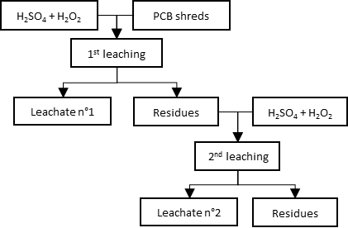
Leaching step (3/3)
Optimization – Multi-step leaching
H₂O₂ quantity divided between 2 leaching steps
Second leaching on residues from the previous one
3 protocols were studied
1-step leaching with 100 % H₂O₂
2-steps leaching 50-50 % H₂O₂
2-steps leaching 75-25 % H₂O₂
Leaching protocol | One step: 100% H₂O₂ | 1st step: 50% H₂O₂ 2nd step: 50% H₂O₂ | 1st step: 75% H₂O₂ 2nd step: 25% H₂O₂
Final copper leaching rate (%) | 82.8 ± 4.4 | 97.3 ± 1.1 | 95.9 ± 2.2
Final tin leaching rate (%) | 96.2 ± 0.5 | 97.8 ± 0.2 | 97.6 ± 0.3
Notes:
Séparer ou fractionner en deux

Slide 13
Recovery of tin

Slide 14

Recovery of tin (1/2)
Leaching H₂O₂ / H₂SO₄
Goal : Precipitate stannic acid selectively and quantitatively
S/L separation
Leachate (Cu²⁺, Sn⁴⁺, Ni²⁺, Al³⁺, Fe³⁺, Zn²⁺)
NaOH
SnO₂, x H₂O precipitation
Stannic acid
Problems :
Spontaneous precipitation of stannic acid at pH ≃ 0.3 – 0.5
Important increase of pH → may decrease purity (goethite precipitation, Cu²⁺ adsorption)
Precipitation delay
Crystal seeding at lower pH → requires pre-made stannic acid
Notes:
AGGRANDIR

Slide 15
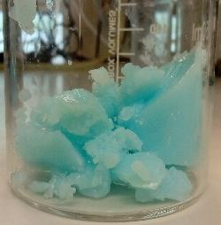
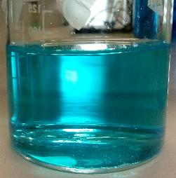
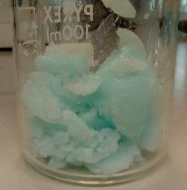
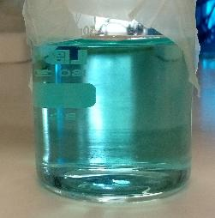
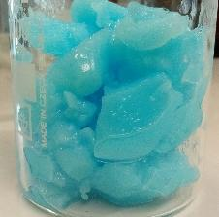
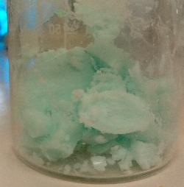
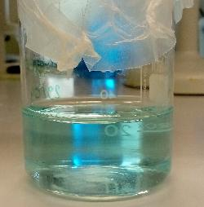
Recovery of tin (2/2)
Crystal seeding
Washing by repulping: 1 mL H₂SO₄ 0,1 M per gram of precipitate
Initial leachate [H⁺] > 1 mol/L
[Cu²⁺] = 1.72.10⁻¹ mol/L
%Cu trapped = 1,8 %
Washing 1
NaOH 5-6 mol/L
Leachate pH = 0
Pur germs (50 g/L solution)
NaOH 5-6 mol/L
[Cu²⁺] = 7.96.10⁻² mol/L
%Cu trapped = 1.4 %
Leachate pH = 1
Washing 2
Centrifugation + filtering
[Cu²⁺] = 4.94.10⁻² mol/L
%Cu trapped = 1.1 %
%Cu trapped = 2.4%
Washing 3
Leachate
[Cu²⁺] = 3.76.10⁻¹ mol/L or 24 g/L
[Sn⁴⁺] = 6.57.10⁻⁵ mol/L or 8 mg/L

Slide 16
Scale-up
Notes:
Changement d’échelle
5g à +100g

Slide 17
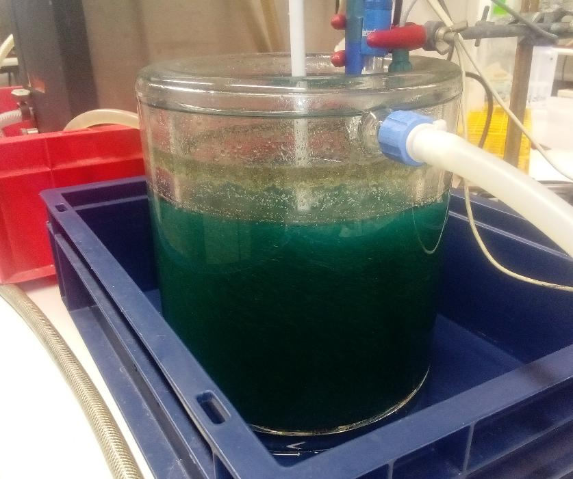
Scale-up (1/3)
Leaching step
Two-step leaching in optimal conditions in a 3 L reactor
Optimal conditions
n H₂O₂ / Σ n métaux = 2 (50-50) n H⁺ / Σ n métaux = 6
Leaching time = 4 h Liquid/Solid ratio = 14 mL/g
Cryostat set at 20°C Stirring rate = 300 rpm
Leachates gathered into one
Metals | Concentration (g/L) | Concentration (mol/L) | Leaching rate (%)
Cu | 37.93 | 5.97*10⁻¹ | > 95
Sn | 5.63 | 4.8*10⁻² | > 95
Ni | 0.83 | 1.4*10⁻²
Zn | 0.49 | 7.5*10⁻³
Fe | 0.17 | 3.0*10⁻³
Al | 0.02 | 7.4*10⁻⁴
140 g of shreds
Notes:
Changement d’échelle 5g à 140g
Mettre taux lixi cu et sn en rouge

Slide 18
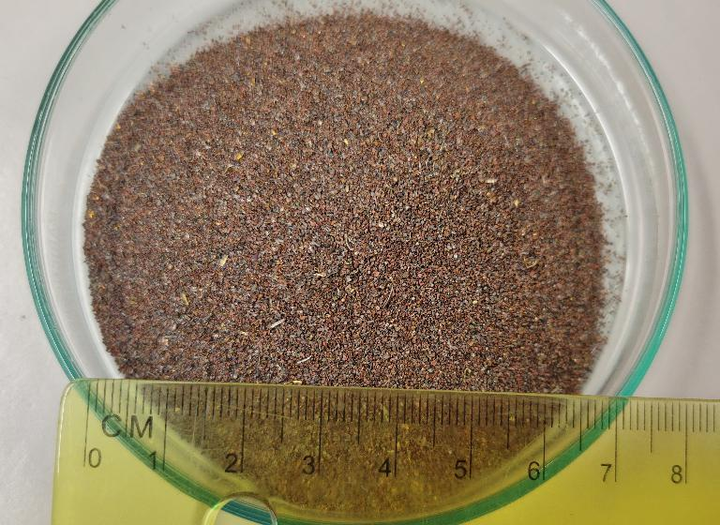
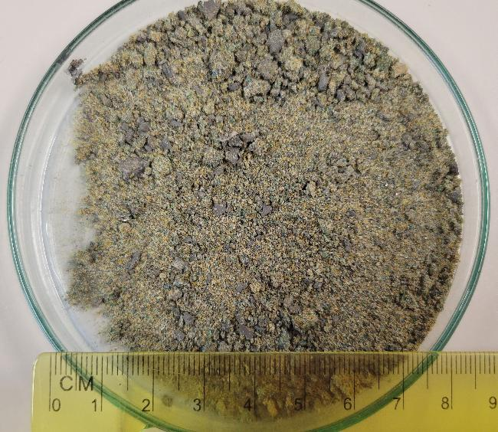
Scale-up (2/3)
Leaching step
BEFORE
AFTER
Mass loss ≃ 82%
Metals | Cu | Sn | Ni | Zn | Fe
Mass content (%) | 69.3 | 12.2 | 2.6 | 1.6 | 0.9
Metals | Al | Pb | Ag | Au | Pd
Mass content (%) | 0.2 | 0.9 | 0.2 | 0.09 | 0.05
Metals | Cu | Sn | Ni | Zn | Fe
Mass content (%) | 21.2 | 2.6 | 6.4 | 0.6 | 5.5
Metals | Al | Pb | Ag | Au | Pd
Mass content (%) | 0.6 | 5.7 | 1.1 | 0.26 | 0.17
Notes:
Mettre échelle

Slide 19
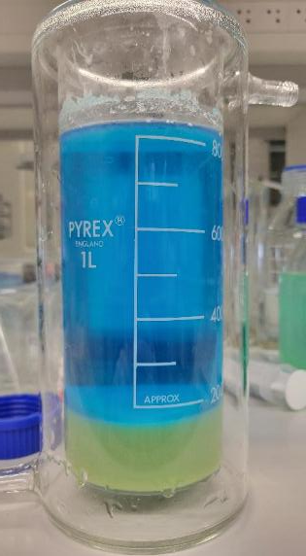
Scale-up (3/3)
Tin recovery
Best results at pH = 2.5
Metals | Concentration (g/L) | Concentration (mol/L)
Cu | 23.21 | 3.65*10⁻¹
Sn | 0.10 | 8.4*10⁻⁴
Ni | 0.46 | 7.8*10⁻³
Zn | 0.29 | 4.4*10⁻³
Fe | 0.10 | 1.8*10⁻³
Al | < 0.01 | < 3.7*10⁻⁴
After 1 wash : 1% copper remaining in precipitate
Low amount of aluminum and iron
-> phytates precipitation step is skipped
Next steps :
Copper electrolysis
Recovery of nickel and zinc (chelating resin)
Notes:
Revoir cadre vert

Slide 20
Conclusion
Maximization of both copper and tin leaching from PCB shreds (< 500 µm) by Design of Experiments methodology
Savings in H₂O₂ consumption with two-step leaching process
Leaching rates of copper and tin > 97 %
Production of a tin precipitate richer than cassiterite
  SnO₂, 2 H₂O (around 1% Cu trapped) represents around 70 % SnO₂
  ⇒ production of tin via pyrometallurgy or electrolysis in alkaline medium
Notes:
3) Recup étain sosu forme sno2 2H20 (+riche que cassi) -> produc pyro
A VERUFUER EN JAUNE
Perspectives

Slide 21
Prospects
Electrolysis of copper incoming
  - Purity of at least 99,99 % required
  - Avoid co-deposition of nickel
Mineralurgical characterization of leaching residues (at least 100 g required)
Development of precious metals enrichment process according to density, electrical conductivity, magnetic susceptibility of different phases
Notes:
À l »oral : recup du cuivre par eelec

